Slide 1
Central ASIA
Fact file

Slide 2
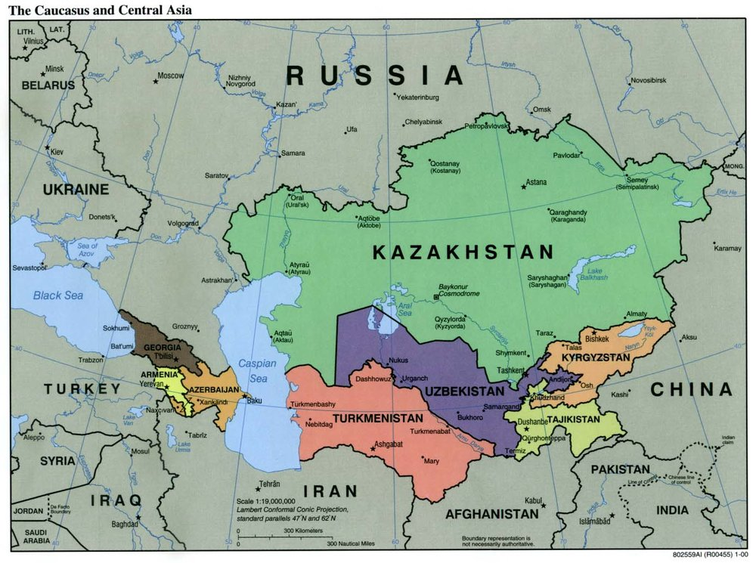

Slide 3
Central Asian republics
Kazakhstan
The country’s enormous mineral deposits make it a world leader in reserves of coal, chromite, lead, and zinc, and its uranium deposits are estimated to be the second largest in the world. Natural gas reserves are substantial as well. Primarily located in the Caspian Sea region, they are found in associated oil and gas fields, such as the giant Karachaganak and Tengiz fields. In 2008, Kazakhstan ranked among the world’s top 20 oil producers. Most oil deposits are located in the Caspian Sea region, with the Kashagan field estimated to contain the world’s fifth largest oil reserves. Kazakhstan has more than 100 oil-producing fields

Slide 4
Central Asian republics
Kyrgyz Republic: Hydroelectricity provides the Kyrgyz Republic with more than four-fifths of its electrical energy
Uzbekistan: The country counts itself among world leaders in gold and uranium reserves, production, and export. Uzbekistan is also rich in natural gas.
Turkmenistan: Its most abundant natural resources are hydrocarbons. Reserves of gas, estimated in 2008 at 9 trillion cubic meters, are the fifth largest in the world. Reserves of oil are estimated at 500 million barrels. Turkmenistan is a major exporter of natural gas, oil, and electricity, mostly to the Russian Federation and Ukraine. Turkmenistan’s proven natural gas reserves are also about 100 trillion cubic feet

Slide 5
Central Asian republics
Tajikistan
Tajikistan is rich in mineral resources, including gold, silver, and uranium. As with the Kyrgyz Republic, however, water may be its greatest resource asset. The country’s hydro capacity places it among the top 10 nations in the world for hydropower potential

Slide 6
Pipelines : CENTRAL ASIA
Kazakhstan-China Crude Oil Pipeline
The 2,798km long Kazakhstan-China pipeline transports crude oil from oil fields located in western Kazakhstan to the Dushanzi refinery located in the Xinjiang Province of China. The pipeline was built to meet China’s growing energy needs. It provided a win-win situation for both Kazakhstan and China by directly linking Kazakhstan’s huge oil resources in the Caspian Sea with China’s strong oil consumer market.

Slide 7
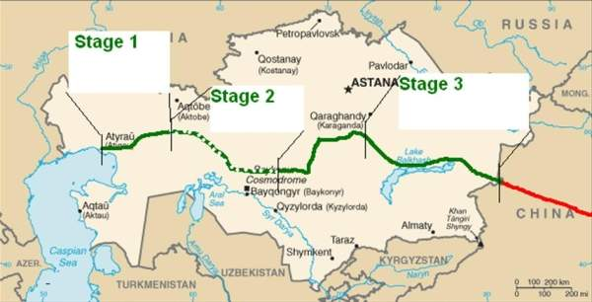
Kazakhstan-China Crude Oil Pipeline

Slide 8
Pipelines : CENTRAL ASIA AND INTEREST OF EXTERNAL ACTORS
Korpeje–Kordkuy pipeline
The Korpeje–Kordkuy pipeline is a 200-kilometre long natural gas pipeline from Korpeje field north of Okarem in western Turkmenistan to Kordkuy in Iran. 135 kilometres of pipeline run in Turkmenistan while 65 kilometres run in Iran. It was built in 1997.

Slide 9
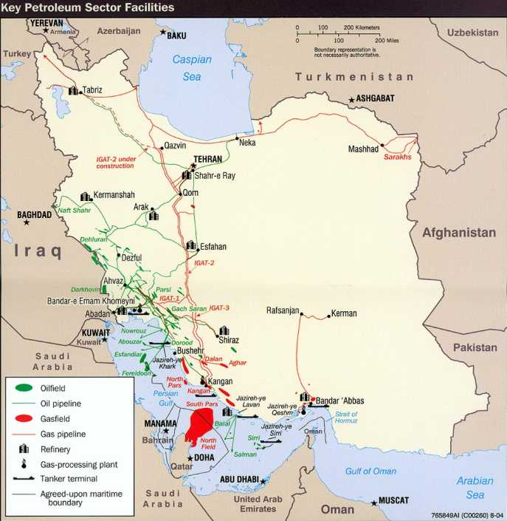

Slide 10
Central Asia–China gas pipeline
The Central Asia-China Gas Pipeline began to be constructed in July 2008, and became operational on December 14, 2009.
The pipeline starts at Gedaim on the border of Turkmenistan and Uzbekistan, running through central Uzbekistan and southern Kazakhstan, and ends at Horgos in China's Xinjiang Uygur Autonomous Region

Slide 11
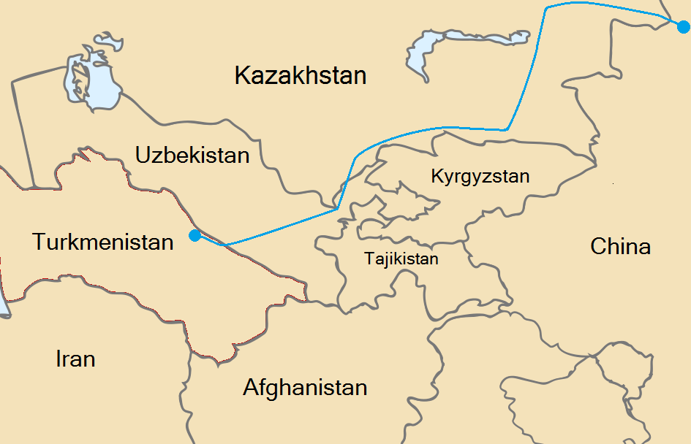
Central Asia–China gas pipeline

Slide 12
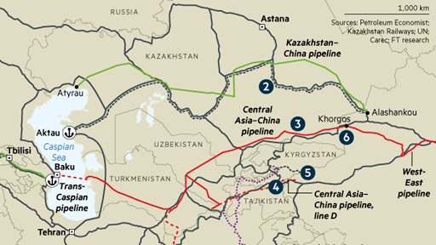
Central Asia – Center gas pipeline system
The Central Asia – Center gas pipeline system is a Gazprom controlled system of natural gas pipelines, which run from Turkmenistan via Uzbekistan and Kazakhstan to Russia

Slide 13
Russia domination on pipelines
The Druzhba pipeline is the world's longest oil pipeline and one of the biggest oil pipeline networks in the world. It carries oil some 4,000 kilometres (2,500 mi) from the eastern part of European Russia to points in Ukraine, Belarus, Poland, Hungary, Slovakia, the Czech Republic and Germany.

Slide 14
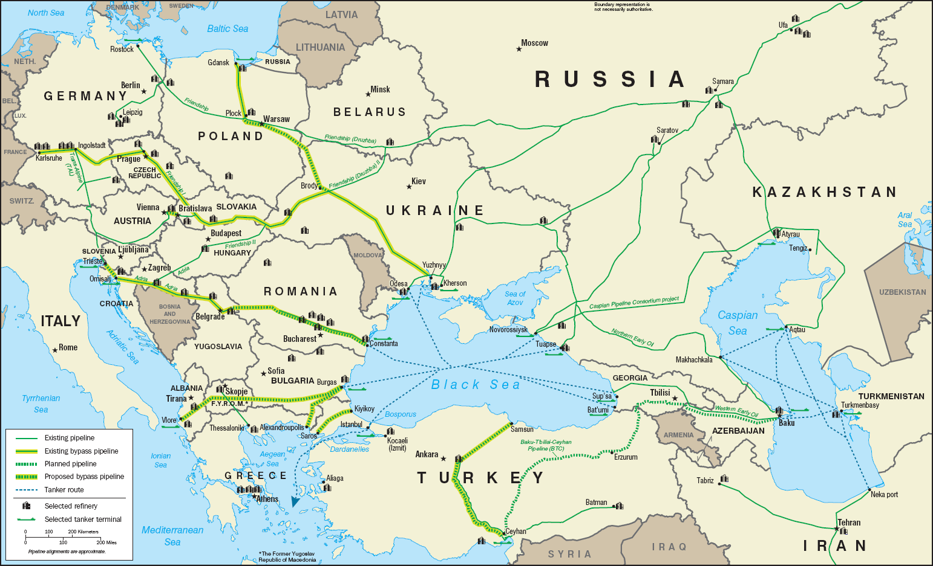
Druzhba pipeline

Slide 15
Baku–Tbilisi–Ceyhan (BTC) pipeline
The Baku–Tbilisi–Ceyhan (BTC) pipeline is a 1,768 kilometres (1,099 mi) long crude oil pipeline from the Azeri–Chirag–Gunashli oil field in the Caspian Sea to the Mediterranean Sea. It connects Baku, the capital of Azerbaijan and Ceyhan, a port on the south-eastern Mediterranean coast of Turkey, via Tbilisi, the capital of Georgia. It is the second-longest oil pipeline in the former Soviet Union, after the Druzhba pipeline. BTC is a major crude oil pipeline that brings Caspian crude to the Mediterranean

Slide 16
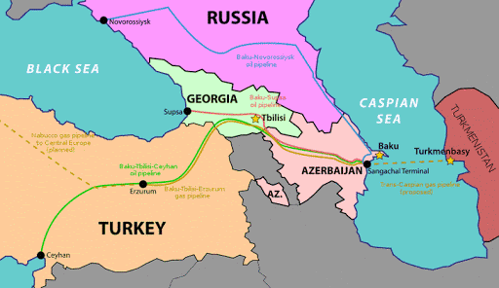
Baku–Tbilisi–Ceyhan (BTC) pipeline

